Slide 1
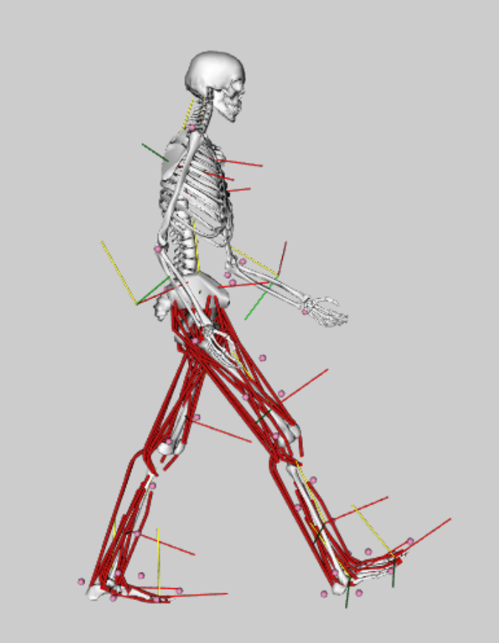
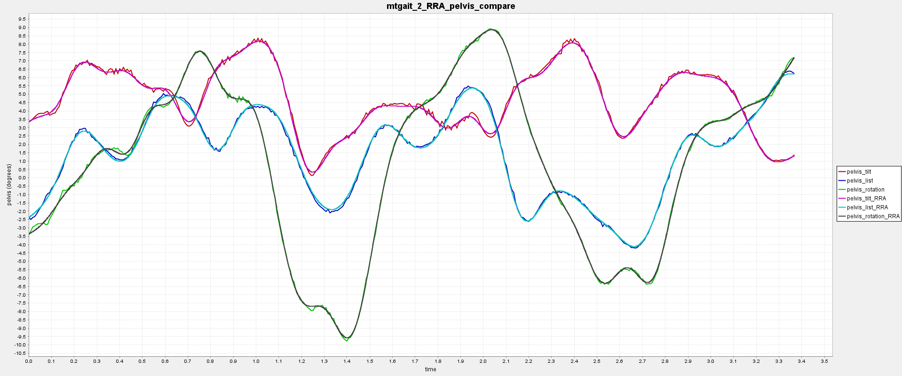
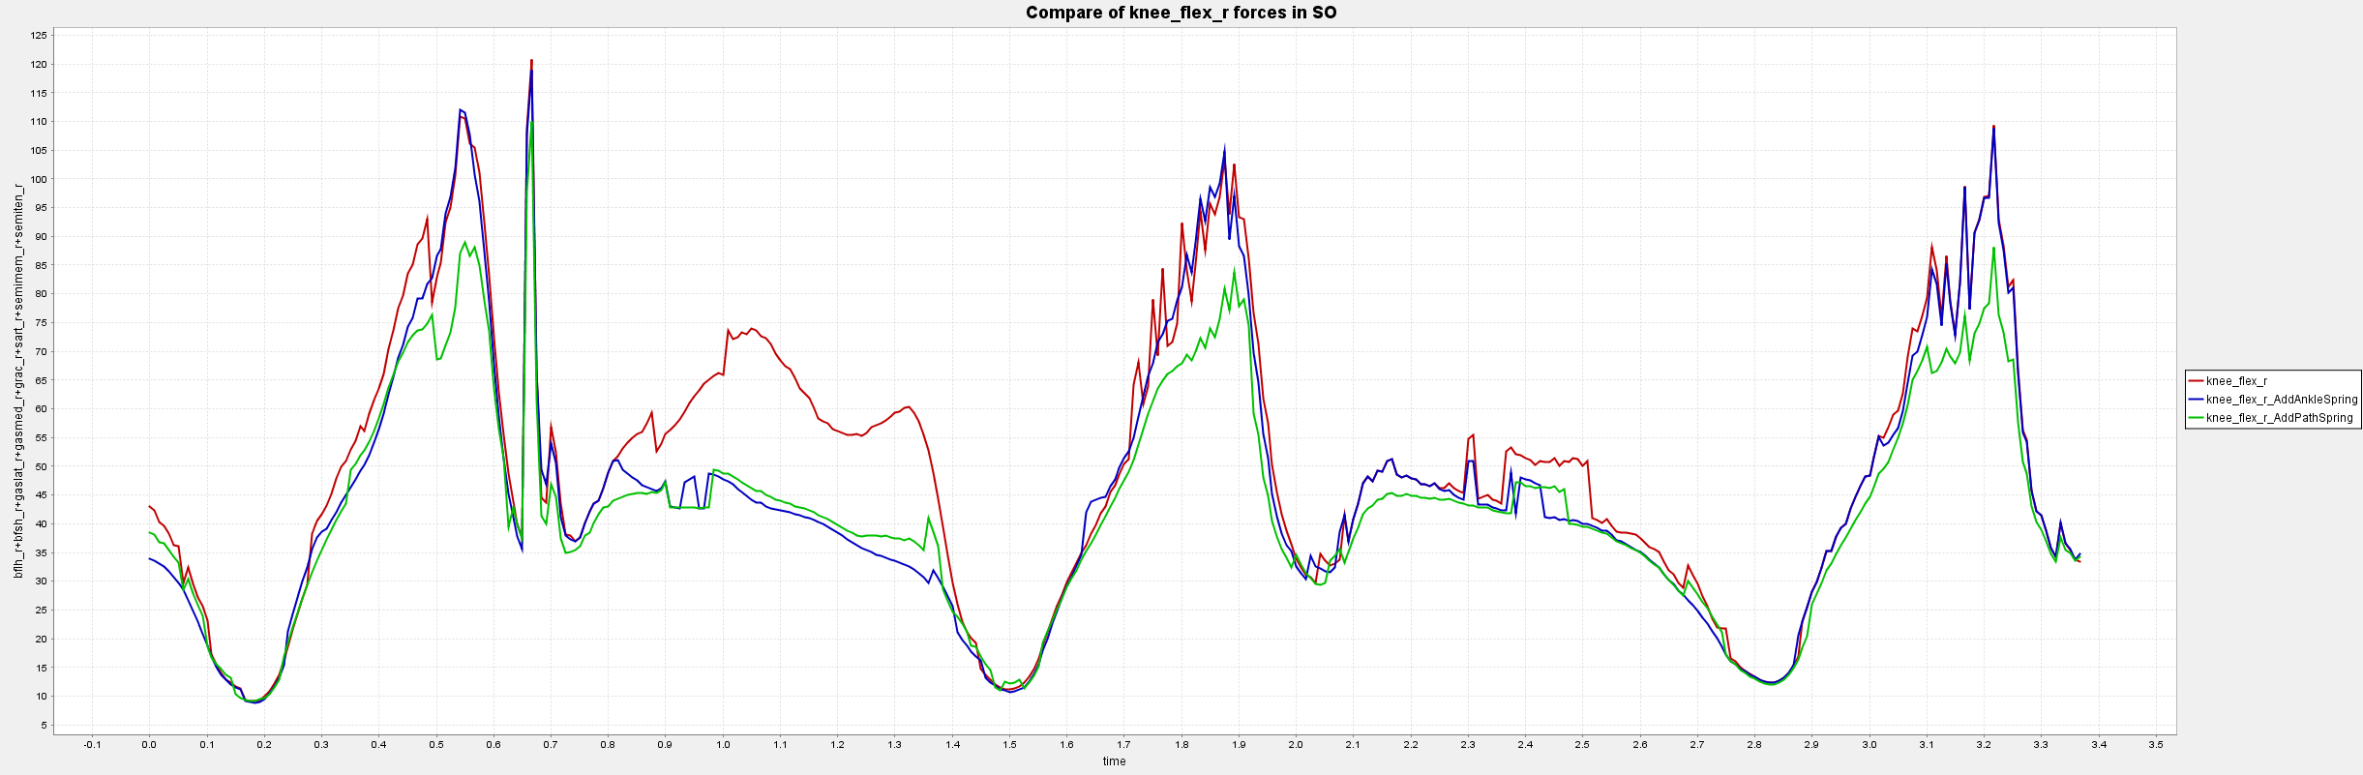
I
Summer OpenSim Practice
Procedures:
Model Scale
Inverse Kinematics
Inverse Dynamics
Static Optimization
Improve SO:
Improve Kinematic Results
Filter the Kinematics
Use RRA tool
Apply Passive Elements
Add Point Actuator
Add Path Actuator
Filter by Using Residual Reduction Algorithms
OpenSim API Scripts
Python
Run Multiple Trails (IK, ID, SO) , RRA, plot, Add Actuators
MATLAB
Run Multiple Trails (IK, ID), Coordinate Transformation
Knee Flexion Forces Change by Adding Actuators

Slide 2
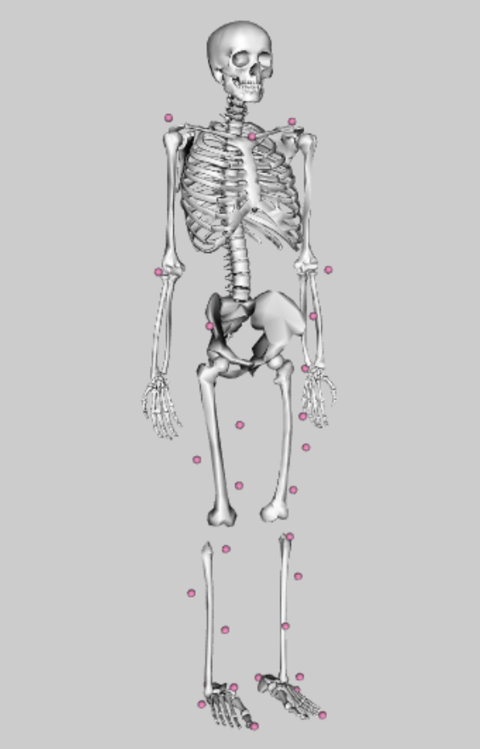
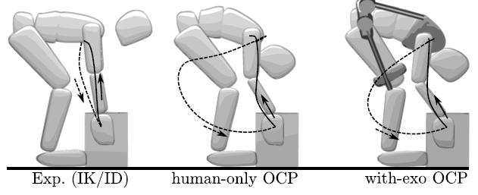
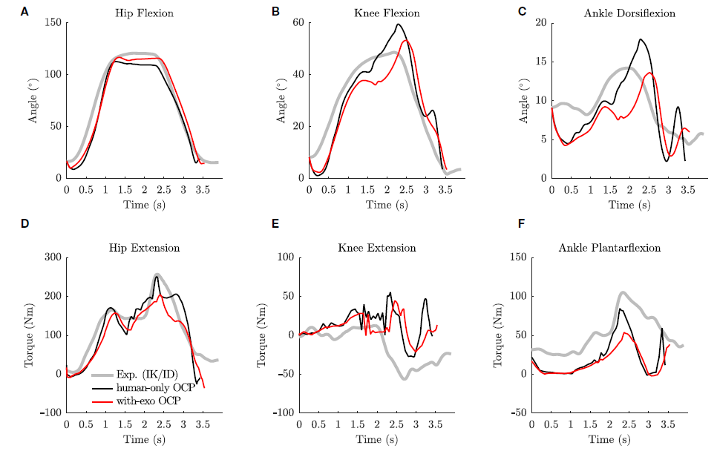
II
Inspiration of Research*
Torque Driven Model
Use optimal control method to predict how much torques will the device provide as will as motions during lifting the box
Prediction Optimization
Cost Function:
Track lower body torques and upper body angles; Minimize jerks and Ground Reaction Errors;
Minimize the symmetric walking errors
Constraints:
Satisfy skeletal dynamics; Match lower body torques using torque control
Controls:
Joint jerks and joint torques
Torque-driven model with 12 DOF
*Millard, Matthew, Manish Sreenivasa, and Katja Mombaur. "Predicting the motions and forces of wearable robotic systems using optimal control." Frontiers in Robotics and AI 4 (2017): 41.

Slide 3
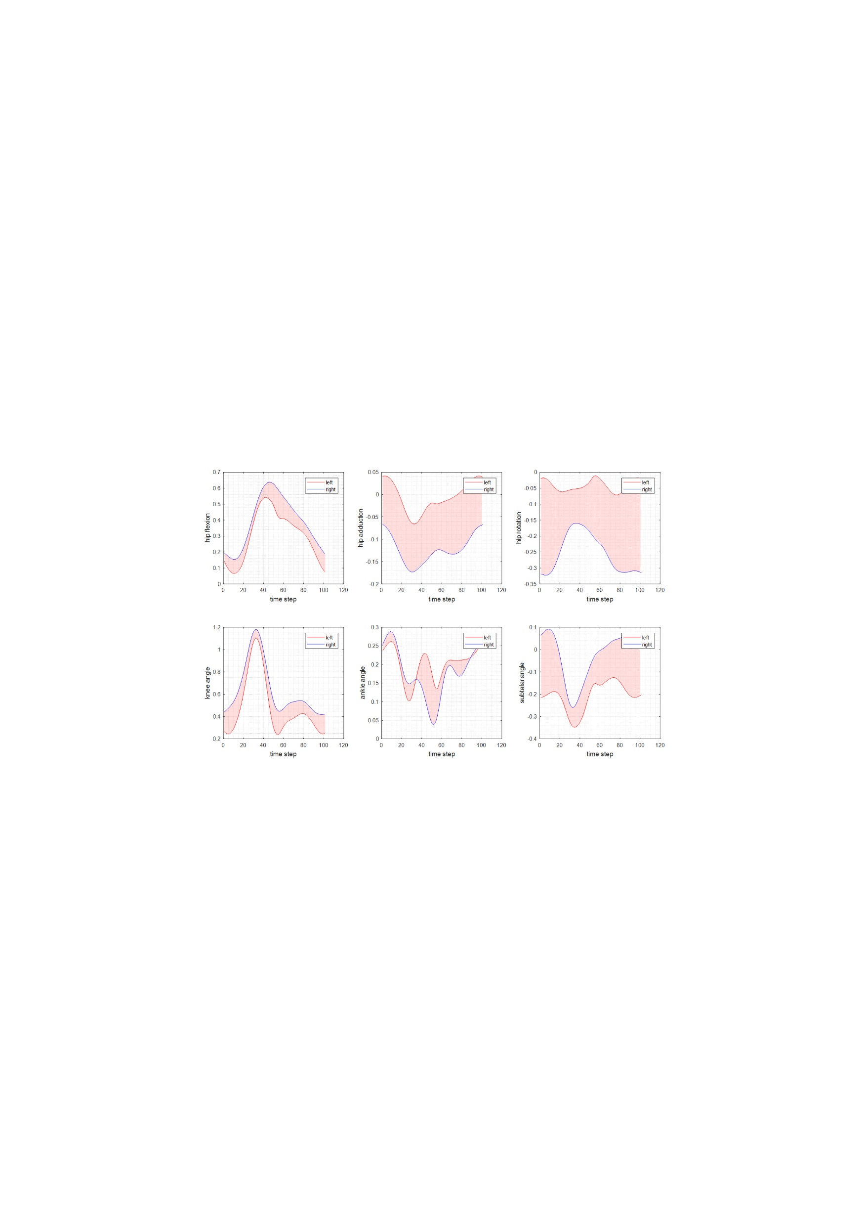
II
Symmetric Walking
Hard to match the experimental data to normal walking data from other experiments
The experimental walking speeds are 0.5 and 0.8 m/s
Different subjects have different gait patterns
Match the right leg (disabled) to left leg in Hip (flexion, adduction, rotation), Knee, Ankle and Subtalar
Match the Phase
Kinematics of Right and Left Legs
Take these differences into the cost function in order to minimize them between left leg and right leg for symmetric walking
Cost Function $F=w_{1}∆q^{2}+w_{2}∆F_{GRF_{R}}^{2}+w_{3}∆F_{GRF_{L}}^{2}+w_{4}∆T^{2}+w_{5}J^{2}+w_{6}∆q_{sym}^{2}$

Slide 4
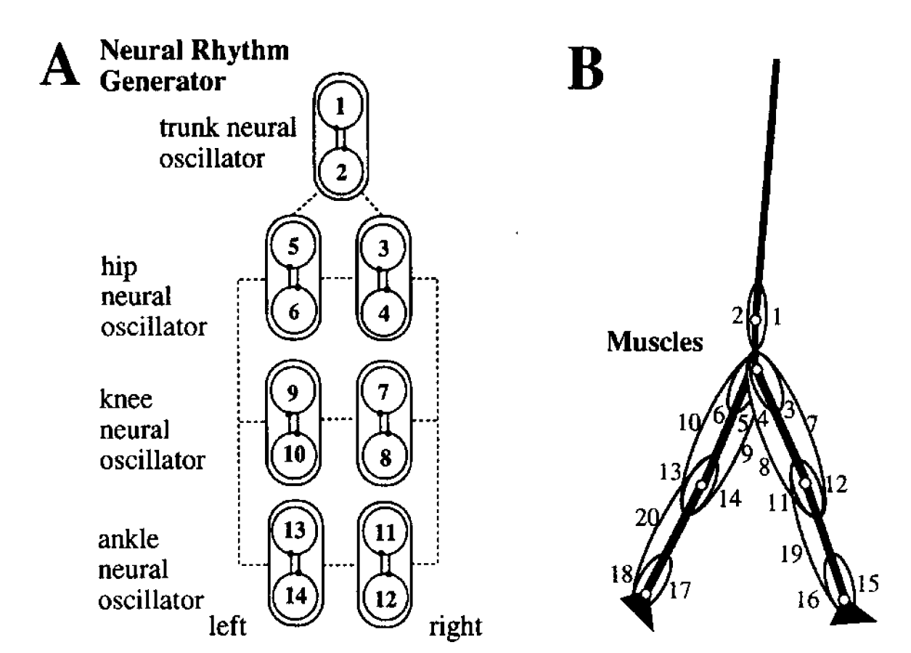
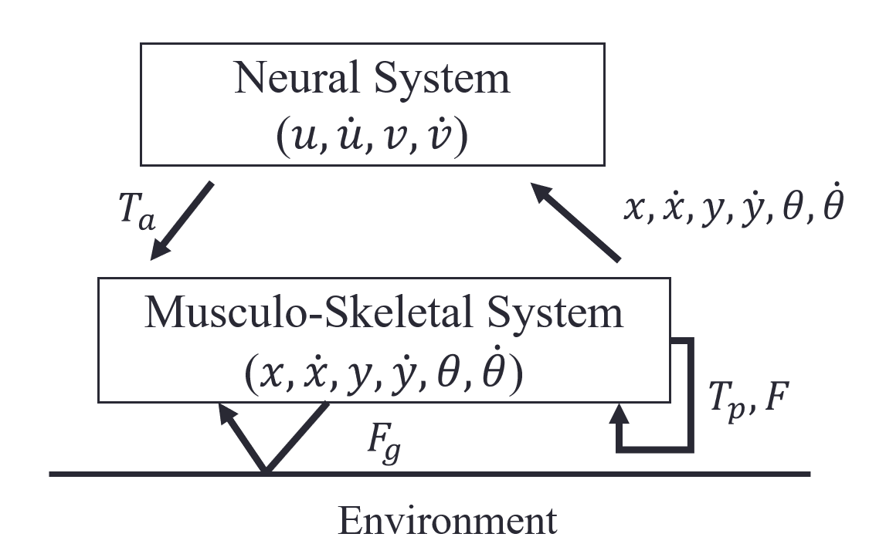
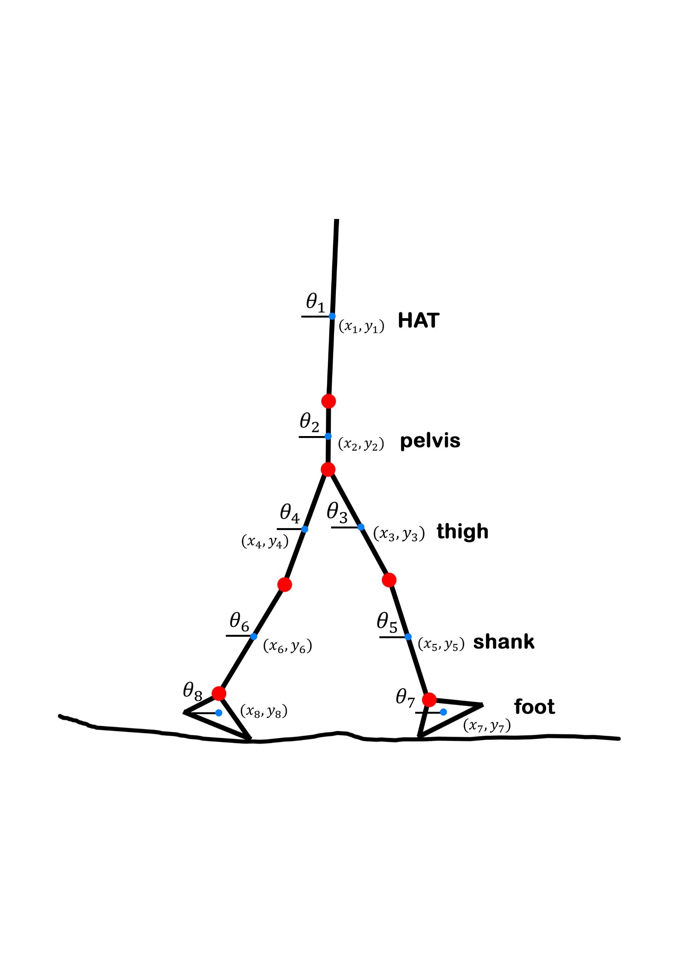
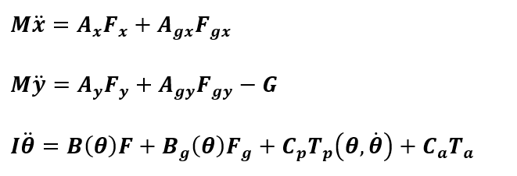
III
Planar Walking Model with Neural Control System*
Self-Control System for Walking
Dynamic System for Walking
Equations of Motion
*Taga, Gentaro. "A model of the neuro-musculo-skeletal system for human locomotion." Biological cybernetics 73.2 (1995): 97-111.

Slide 5
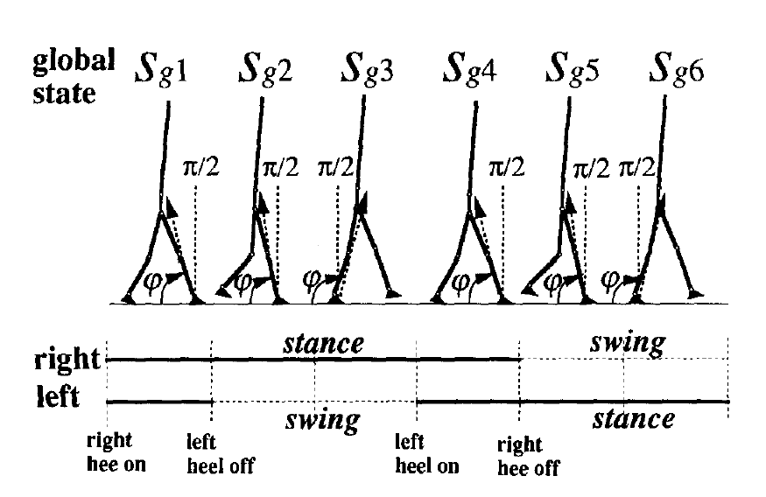
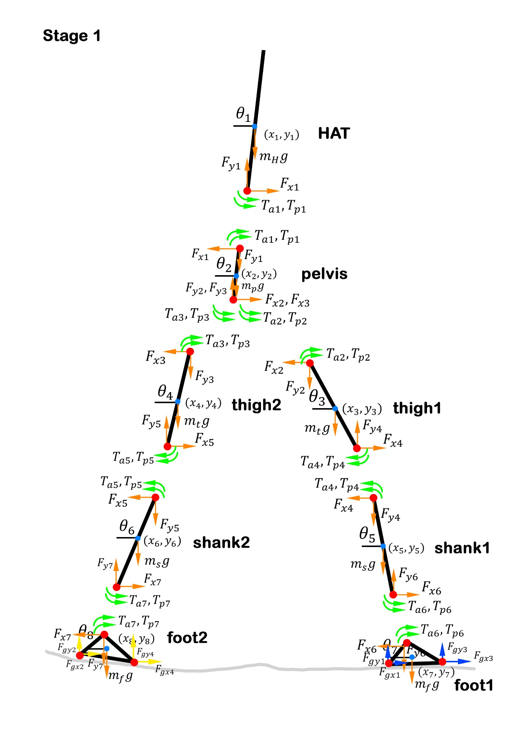
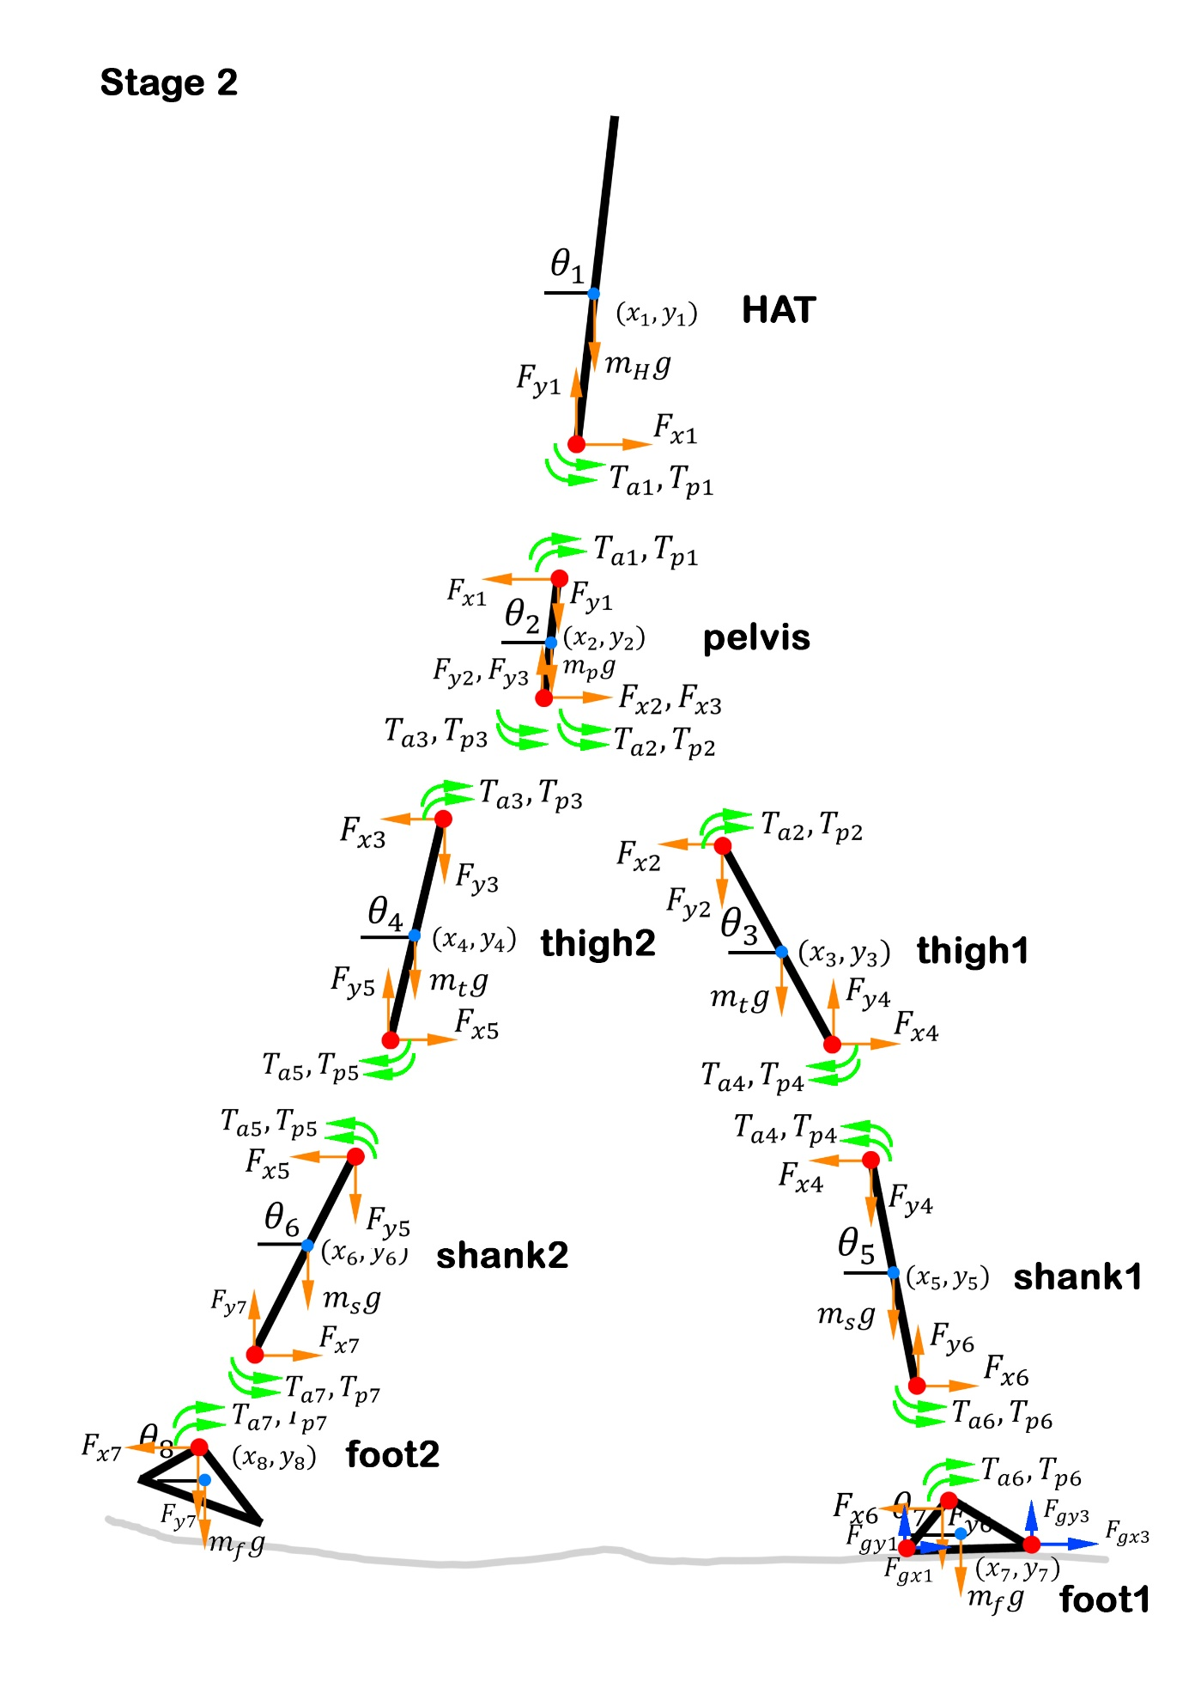
III
Switch of Dynamic Systems during Phases
Stage 1
Stance Phase
Double Support
Stage 2
Swing Phase
Single Support
When Knee or Heel’s position is on or below y=0 (ground), there will be ground reaction force acting on it, which is represented as a spring-damper.

Slide 6
III
Simulation Results
Stage 6
Swing phase
Single support
Stage 1
Stance phase
Double support
Stage 2
Swing phase
Single support

Slide 7
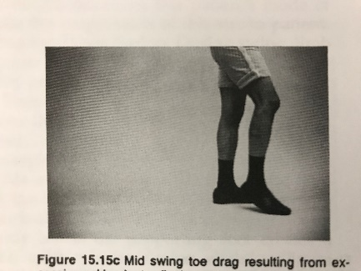
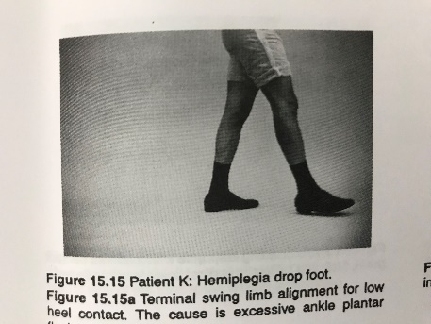
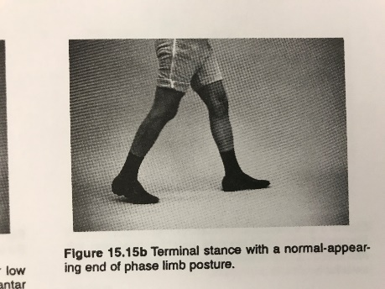
III
Foot Drop Problem Characterization*
Terminal stance with a normal appearing end of phase limb posture
Mid swing toe drag resulting from excessive ankle plantarflexion with normal hip and knee flexion
Terminal swing limb alignment for low heel contact due to excessive ankle plantarflexion
Mimic the characteristics of foot drop in simulation
Set the initial condition to “toe dragging”
Disable the neural oscillator at ankle
*Perry, Jacquelin, and Jon R. Davids. "Gait analysis: normal and pathological function." Journal of Pediatric Orthopaedics 12.6 (1992): 815.

Slide 8
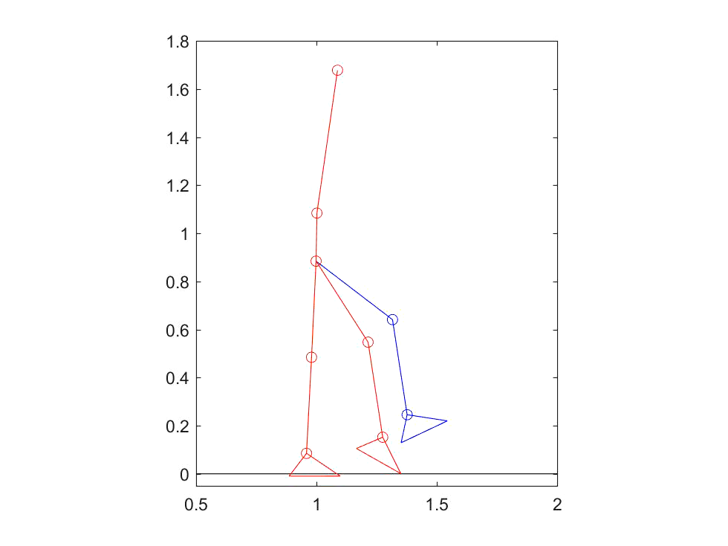
III
Compare of Normal and Foot Drop Gait
Video
Normal(blue); Foot Drop(Red)
Angle differences in thigh, shank and foot between normal and foot drop gait

Slide 9
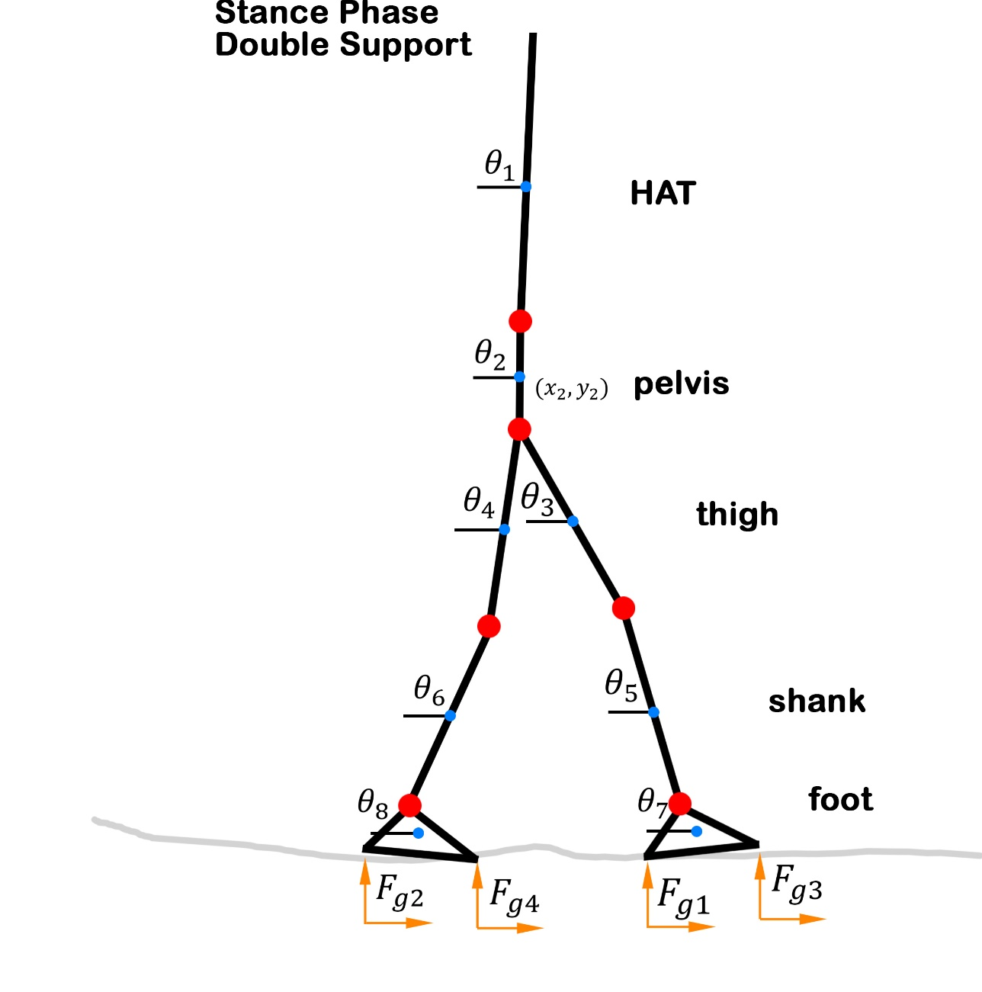
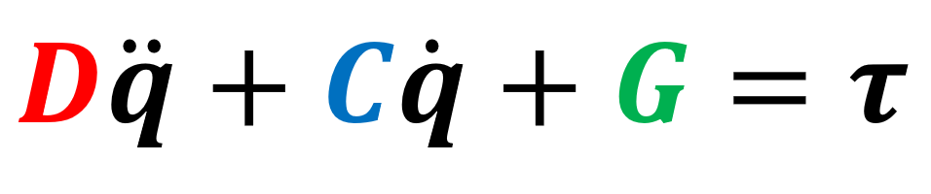
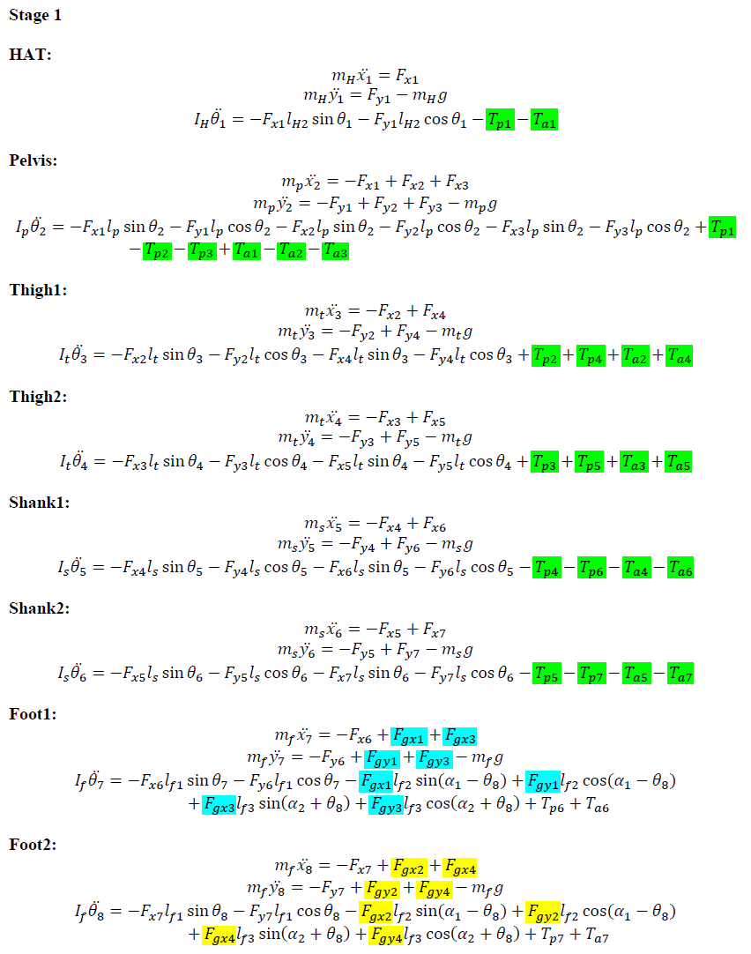
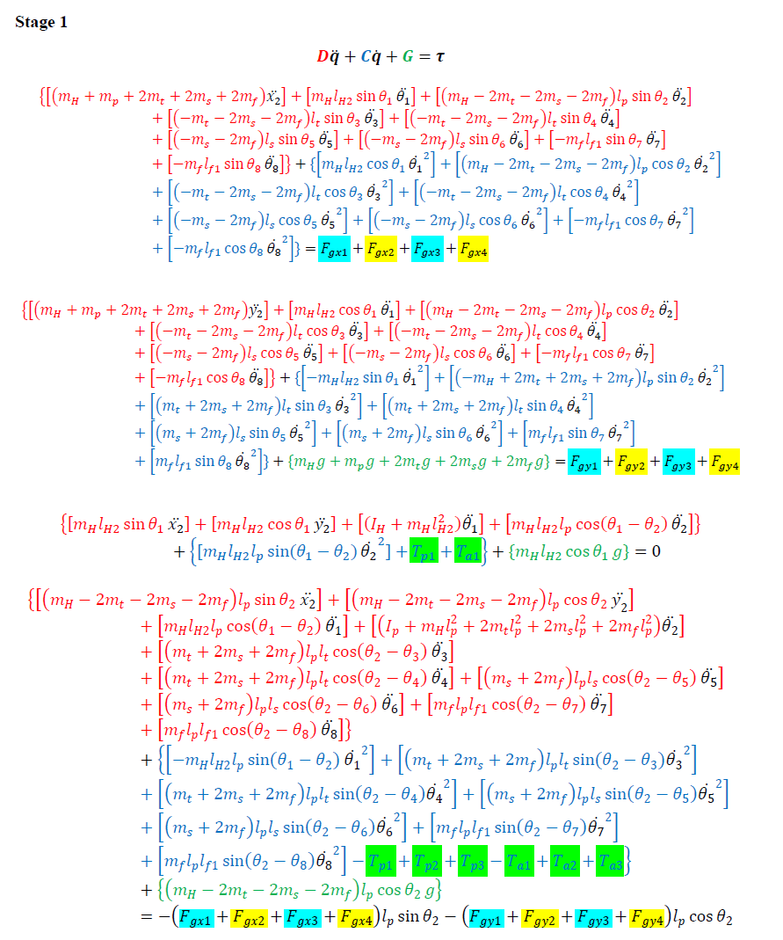
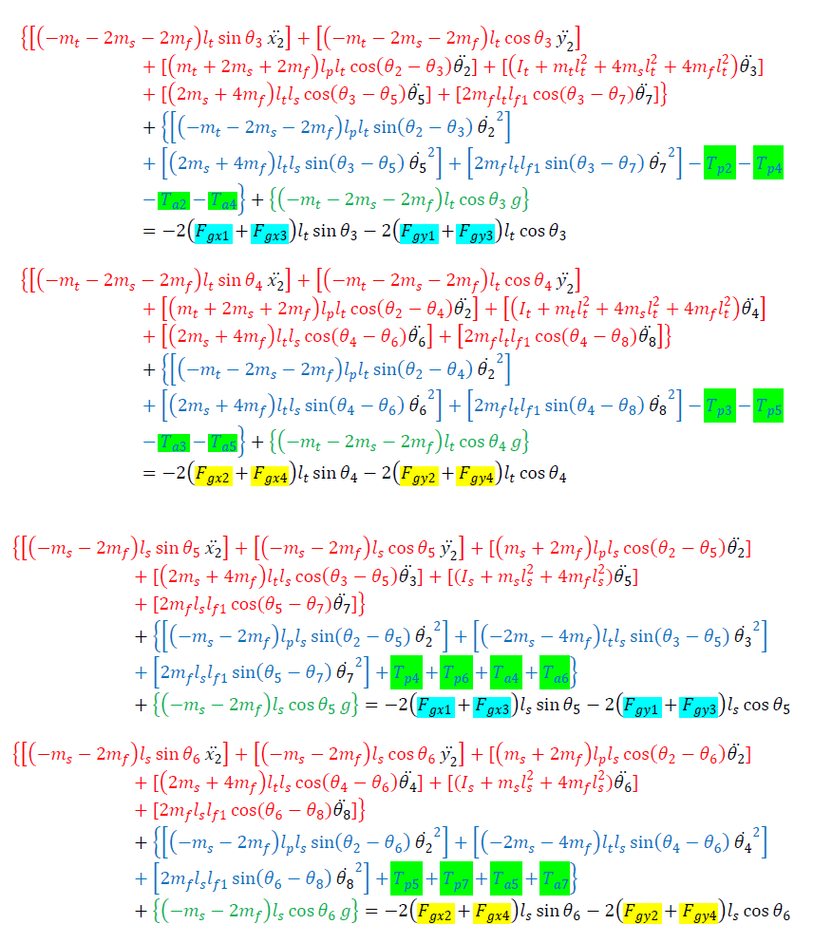
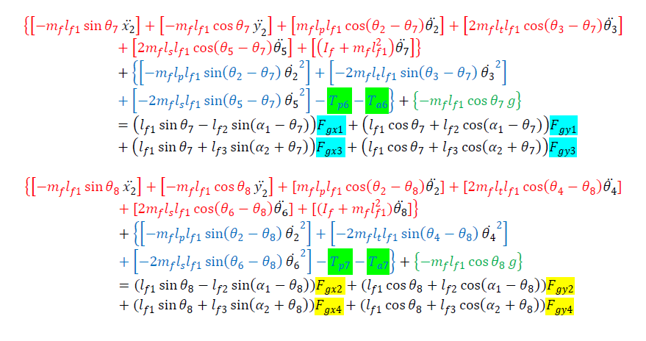
III
Reduced Model

